Slide 1
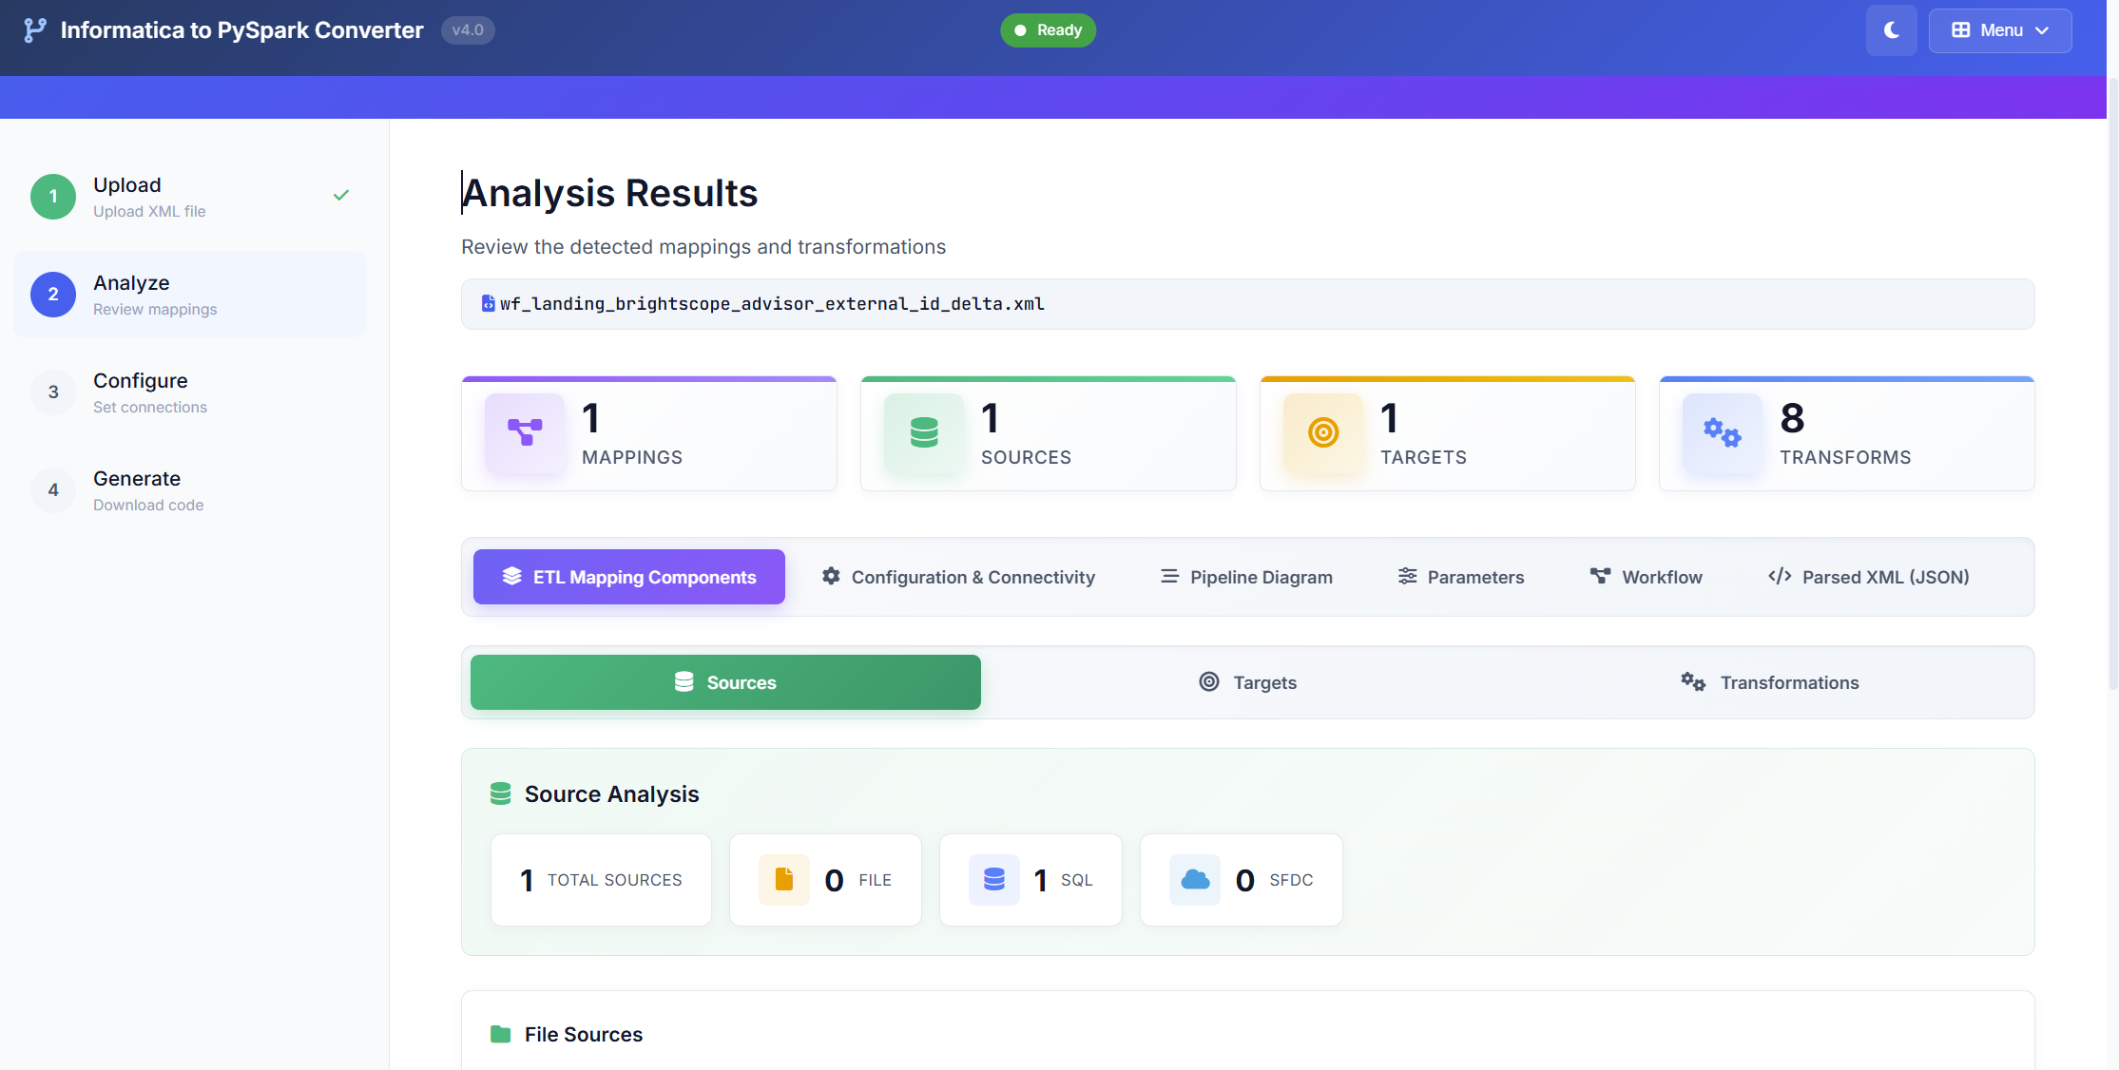
Informatica to PySpark Converter v4.0
Automated ETL code generation 70% automated conversion + 30% guided finalization and Speed, without sacrificing correctness.
Converts Informatica mappings into an initial PySpark ETL draft
Works with SQL Server for both input and output and Uses a standard configuration template
Covers common transformation patterns and business rules through automated translation
Includes performance-oriented defaults to support efficient processing after finalization
Delivers a complete package:)
Data Engineering Platform
@Nick Development Technical Presentation | 2026

Slide 2







Accelerating Informatica to PySpark Migration
70%
Informatica workflow
XML
Converted Pyspark
code
Automated Coverage
XML
PY
Auto-converts most Informatica mapping logic into PySpark draft code.
INFORMATICA
Informatica to PySpark
Converter
4-5 Hour
Time Saved/Mapping
Cuts manual rewrite time with faster analysis, code generation, and templating.
Converted Code
Compare Code
Code
Review
Code Testing
Code Deployment
30%
Speeds up ETL modernization by converting Informatica mappings into PySpark code drafts. Combines automation with guided finalization to ensure accuracy, control, and consistency across migrations.
Assisted Finalization
Reviewer-led tuning for edge cases, performance, and code readiness.

Slide 3
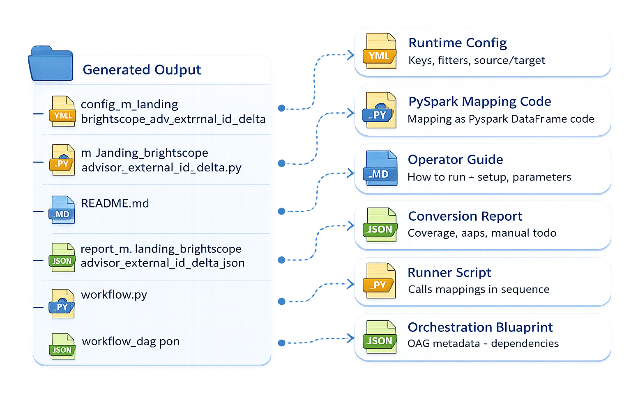

Generated Output Structure
The converter generates a PySpark ETL framework with code, config, and comprehensive validation report.

Slide 4




Modules & Capabilities
Modular design: each module handles specific conversion tasks from Informatica XML to PySpark.
PySpark Code Converter
Expression Converter
Improve Code Quality
Mapping Diagram
Auto-cleans generated code for production readiness. Applies formatting, best-practice refactors, performance hints, warnings fixes, and adds validations for safer execution.
Converts Informatica mapping/workflow XML into structured, runnable PySpark DataFrame code. Generates sources → transformations → targets flow with reusable templates, logging, and config-driven execution.
Translates Informatica expressions into equivalent PySpark SQL / DataFrame functions. Supports common functions like IIF, DECODE, NVL, SUBSTR, TO_DATE, ADD_TO_DATE with datatype handling and null safety.
Creates a visual diagram of the Informatica mapping flow. Shows sources → transformations → joins/lookups/aggregations → targets, making review, debugging, and sign-off faster.

Slide 5
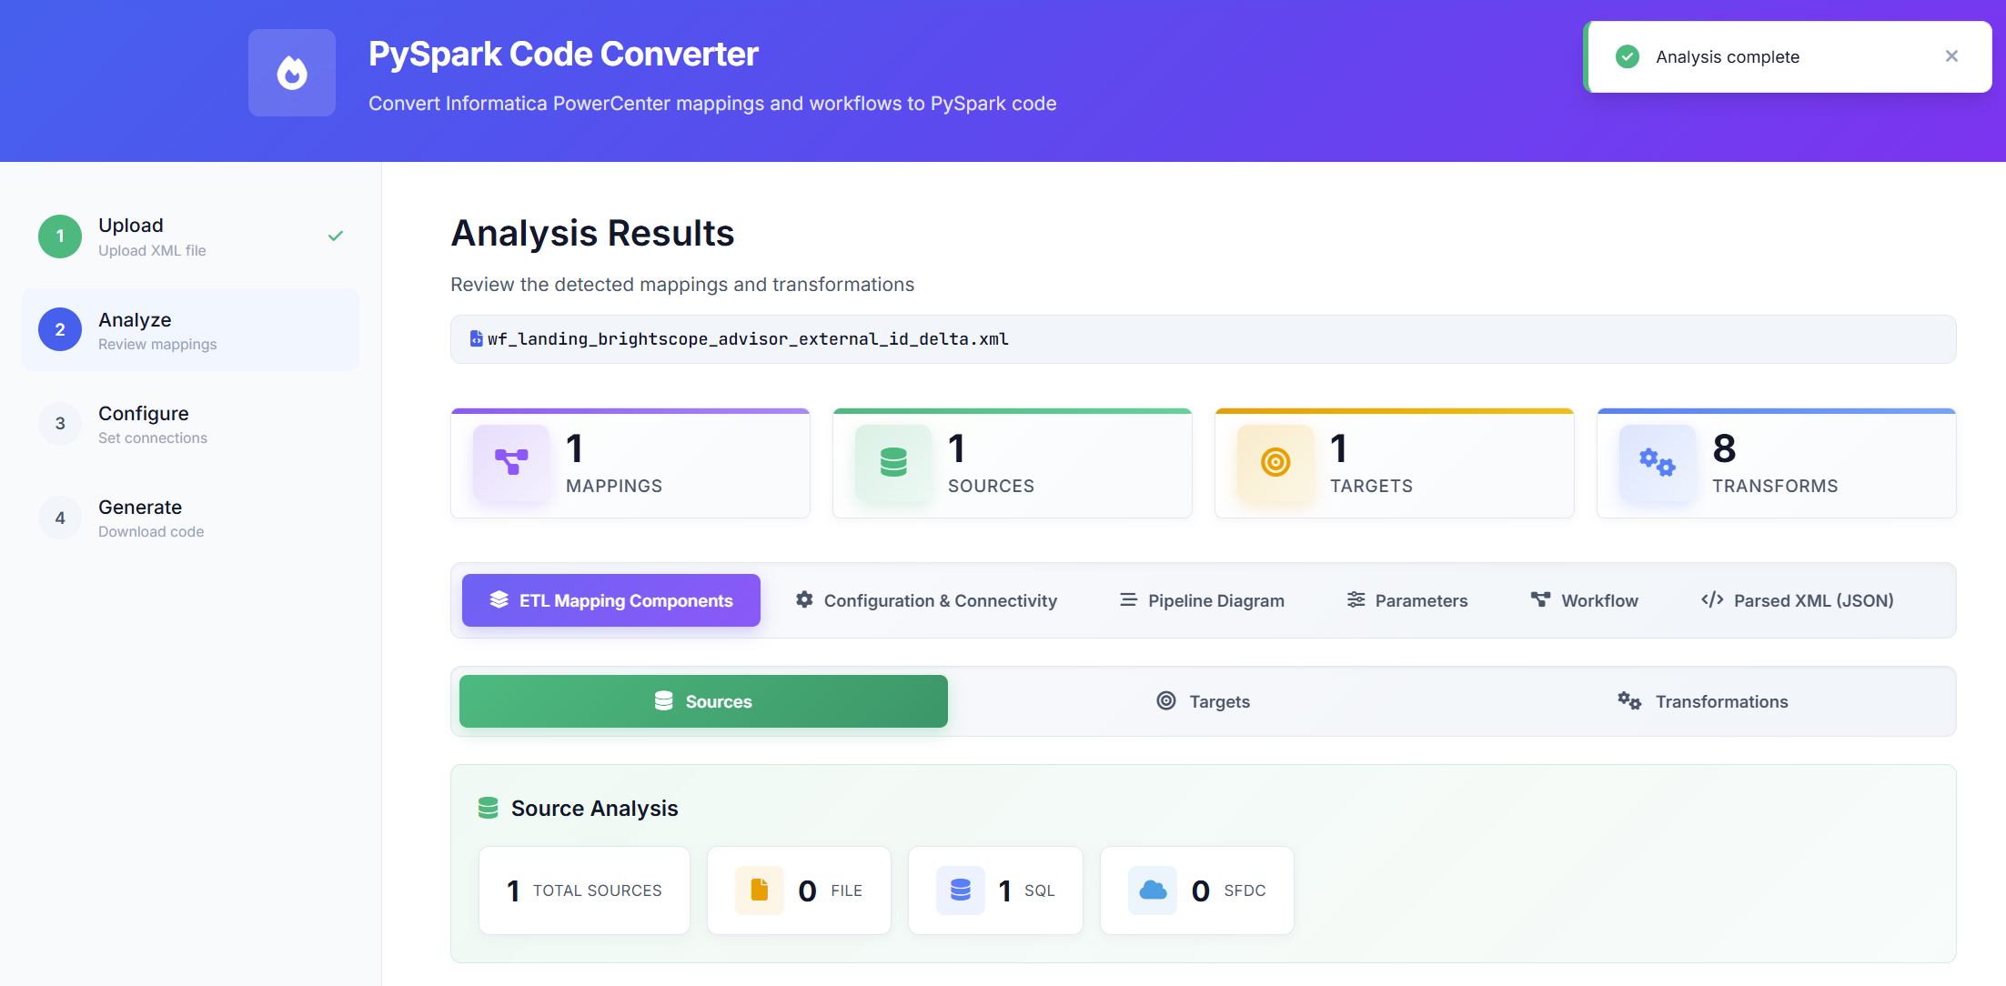
PySpark Code Converter - Informatica Xml Analysis Steps
Analyzes the Informatica XML and summarizes mappings, sources, targets, and transformations to prepare for PySpark code generation. This page analyzes the uploaded
Informatica PowerCenter XML and automatically extracts the full ETL blueprint—mappings, source systems (SQL/File/SFDC), target objects, and all

Slide 6
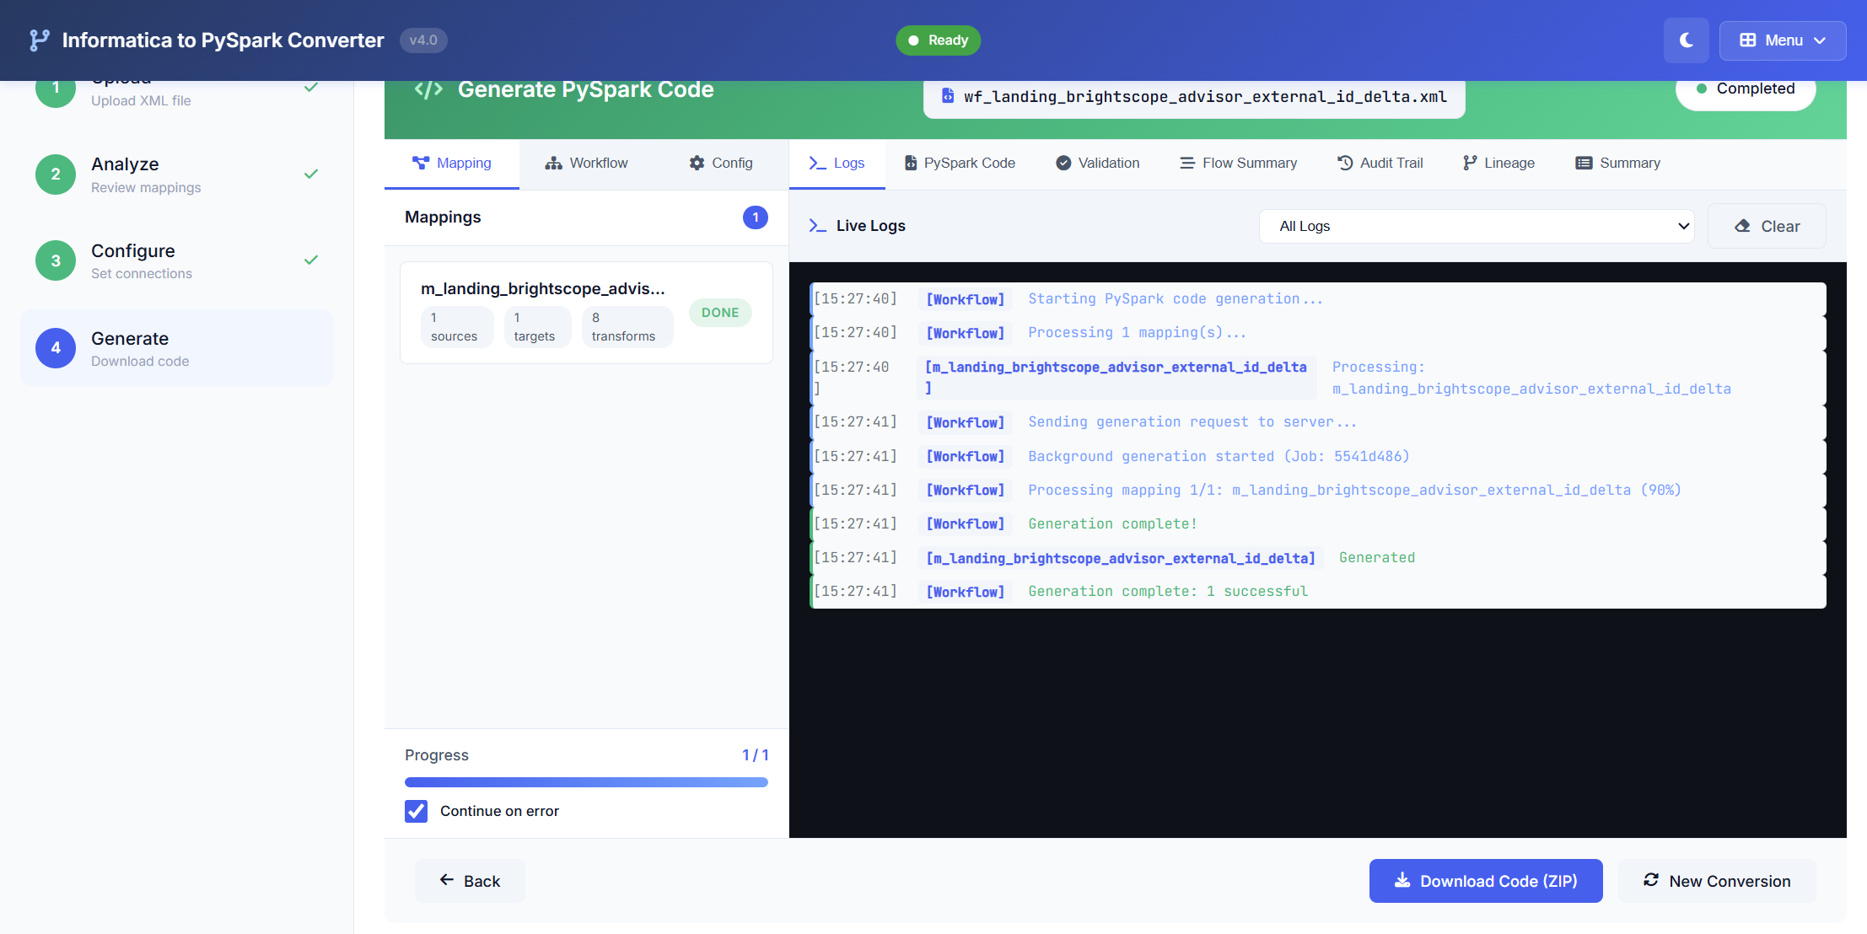
PySpark Code Converter - Generate PySpark Code
Generate PySpark code from the analyzed Informatica XML with a single click. Track progress in real-time via live logs, mapping status, and completion badges.
Run validation, review flow summary and lineage, then download the full code package (ZIP) to deploy and run in your target environment.

Slide 7
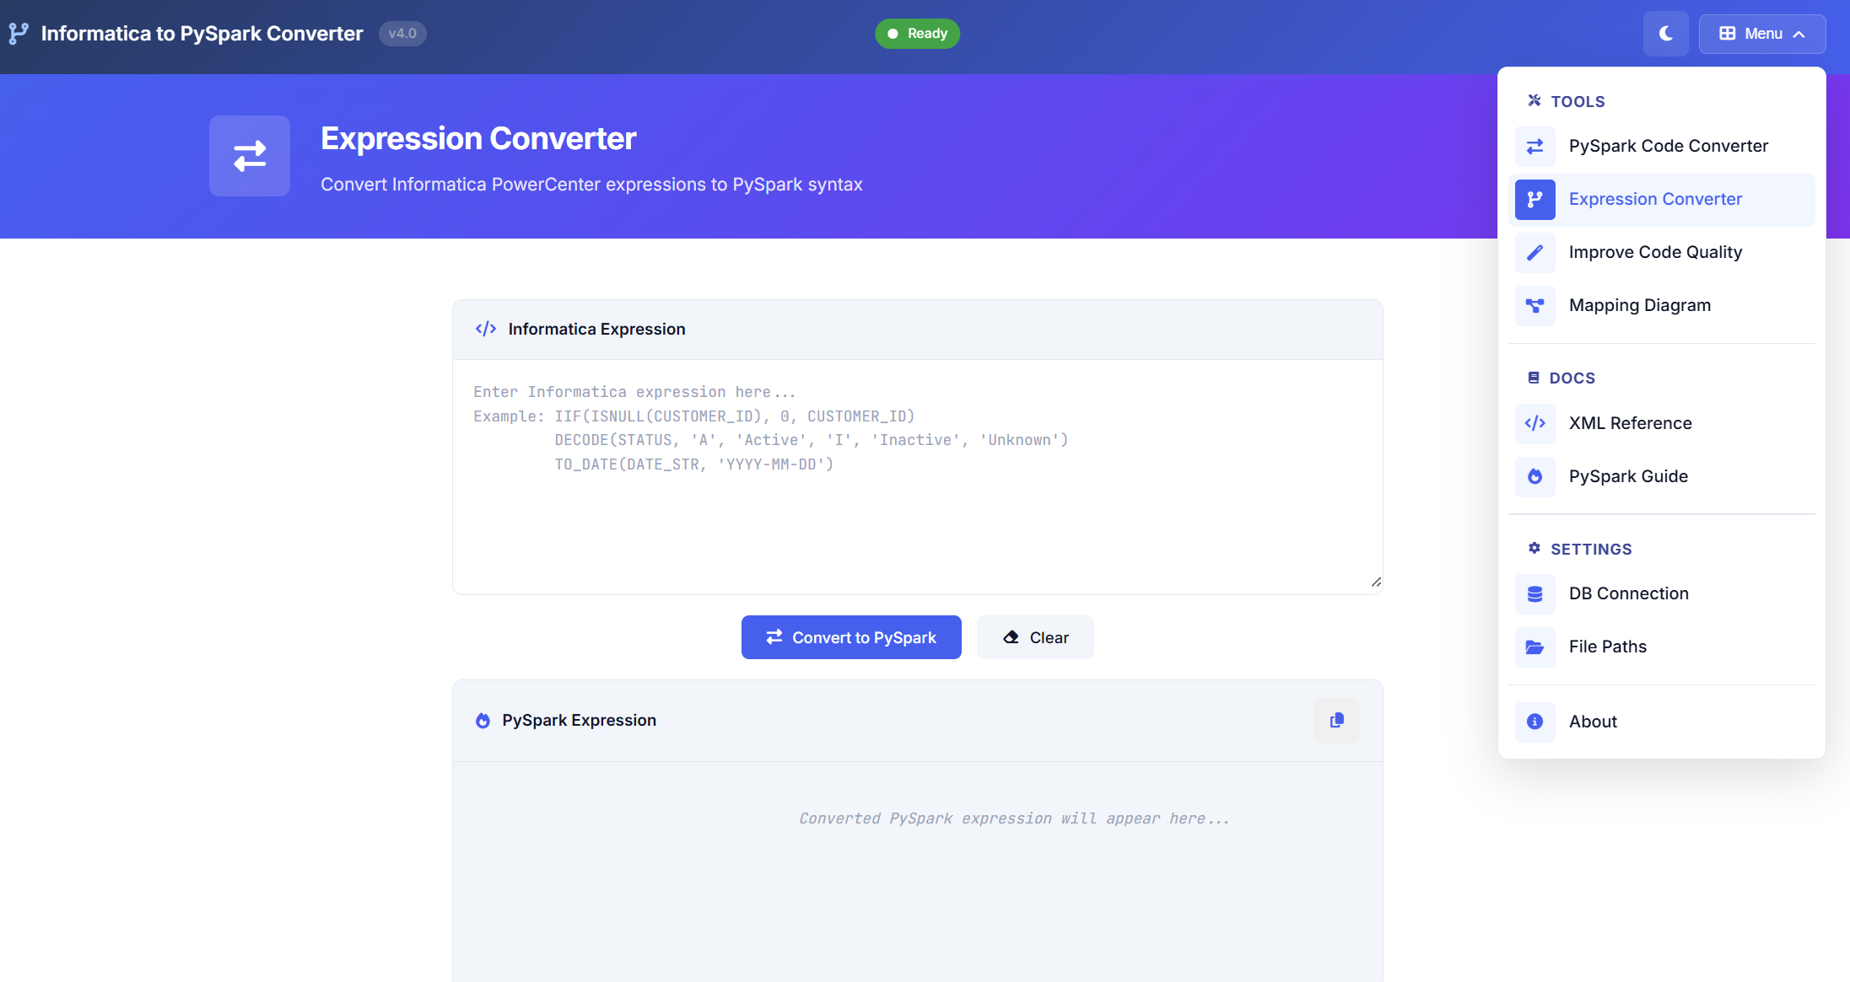
Expression Converter
New Expression Converter module converts Informatica PowerCenter expressions into equivalent PySpark syntax instantly. Paste any IIF/DECODE/TO_DATE style logic,
click Convert to PySpark, and get ready-to-use Spark expressions with copy support—reducing manual rewrite errors and speeding up mapping conversion

Slide 8
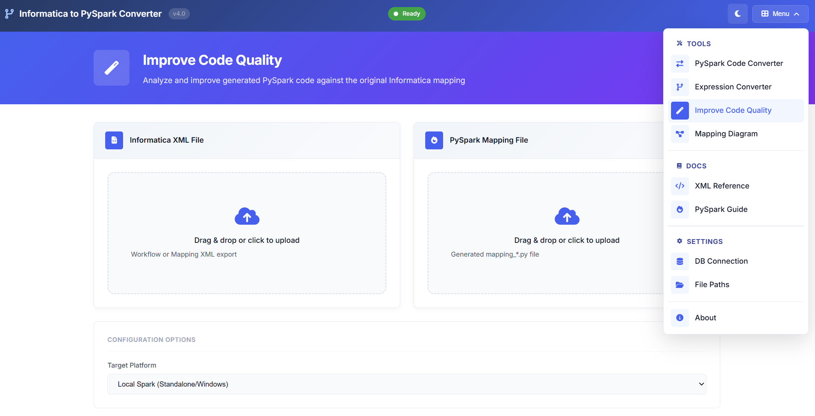
Improve code Quality
New Improve Code Quality module validates whether the generated PySpark mapping matches the original Informatica XML. Upload both files to run a
side-by-side comparison, detect missing logic, wrong joins/filters, schema mismatches, and config gaps, then get a clear error list with fix suggestions.

Slide 9
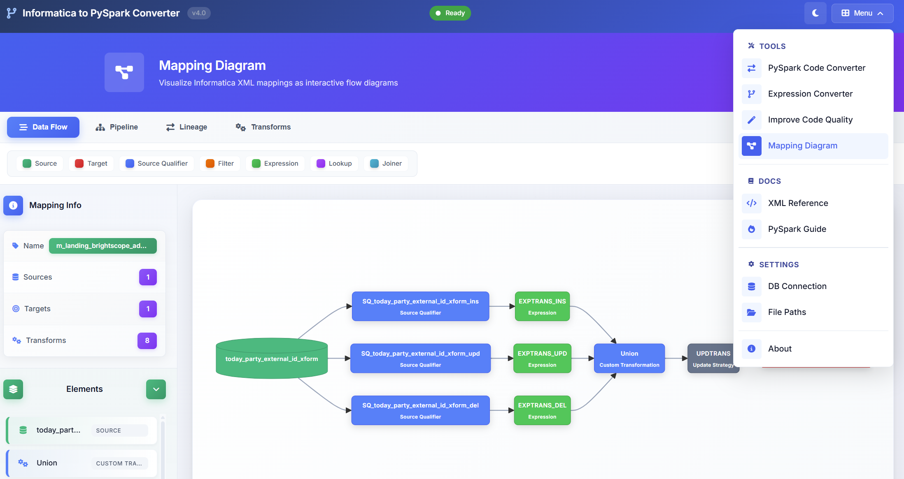
Mapping Diagram
New Mapping Diagram module visualizes Informatica XML as an interactive flow designer. Instantly see sources, targets, and all transformations (SQ, filter, expression,
lookup, joiner, union, update strategy) in one graph. Use it to validate end-to-end logic and confirm the conversion flow.

Slide 10
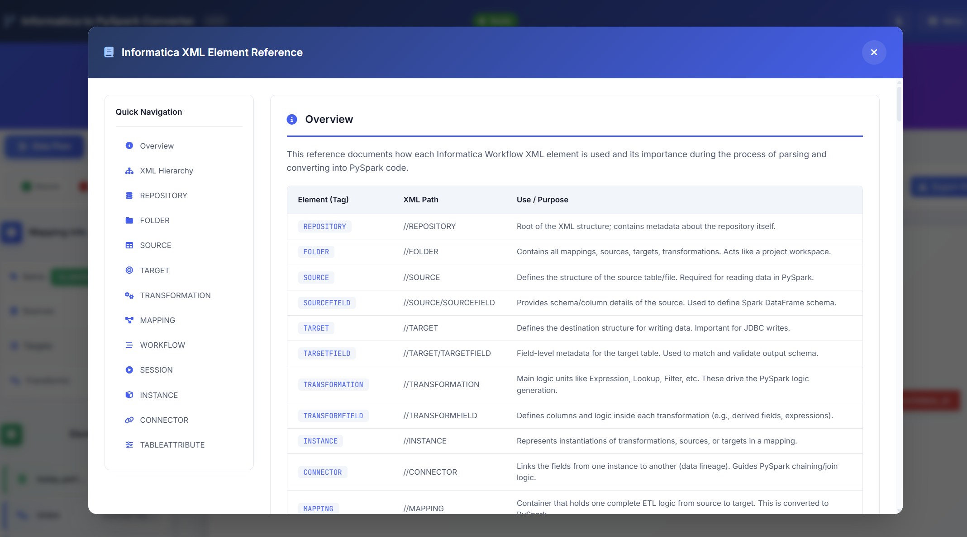
DOC - Informatica xml element
Informatica XML Element Reference is a built-in documentation module that explains every key XML tag (Repository, Folder, Source, Target, Transformation, Mapping,
Workflow, Session, Connector, etc.). It shows XML path and purpose, helping teams validate parsing rules, debug conversions, and ensure correct PySpark generation.

Slide 11
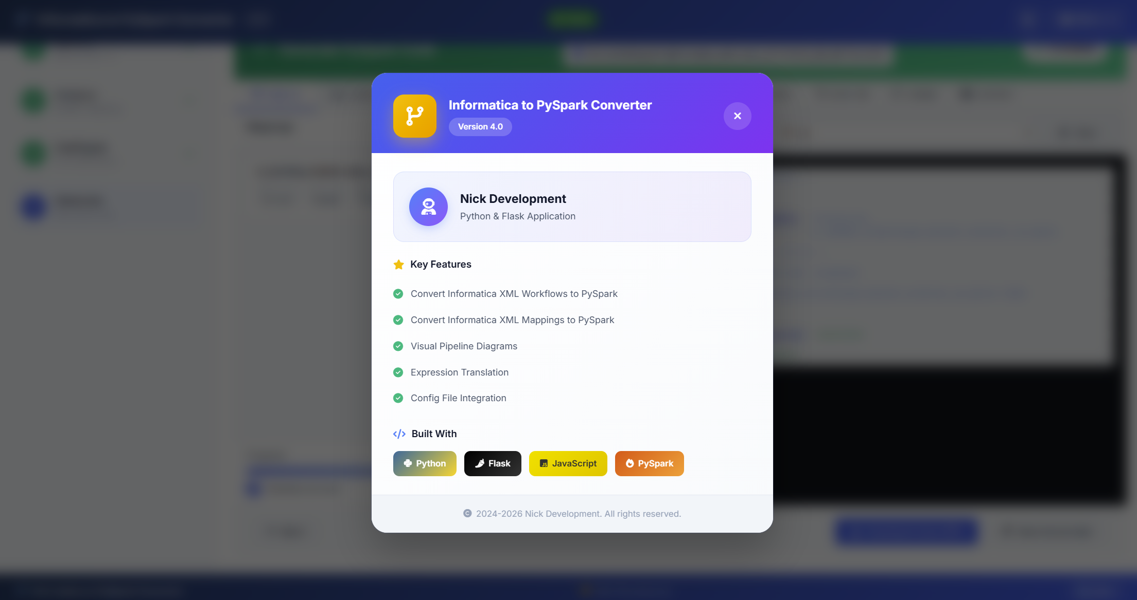
Product Overview & Tech Stack
About/Doc page gives a quick product overview and key capabilities—Informatica XML Workflow & Mapping to PySpark conversion, visual pipeline diagrams,
expression translation, and config file integration. It also lists the tech stack used to build the tool: Python, Flask, JavaScript, and PySpark.

Slide 12
What’s Auto-Converted vs What Needs Review
Automated (mostly)
XML parsing & object discovery (mappings, workflows, sessions, instances, connectors)
Mapping flow extraction (source → transformations → target order)
Standard transform conversion (SQ, Filter, Expression, Joiner, Lookup, Union, Sorter, Aggregator*)
Basic expression translation (IIF, DECODE, NVL/ISNULL, TO_DATE, string/date ops)
Schema extraction (source/target columns, datatypes where available)
JDBC read/write scaffolding (SQL Server/Postgres pattern code)
Config template generation (env placeholders, connection blocks)
Code packaging (folder structure + zip output)
Logs + conversion report (what converted, what flagged)
Performance tuning (repartitioning)
Datatype & format mismatches (date formats, trimming rules)
Custom SQL / overrides in Source Qualifier (hints, unions, complex joins, subqueries)
Assisted / Manual Review (needs human)
Complex expressions (nested DECODE/IIF, custom functions, edge null logic)
Custom SQL / overrides in Source Qualifier (if having custom param)
Update Strategy semantics (DD_INSERT/UPDATE/DELETE handling, merge/upsert logic)
Lookup behavior tuning (cache logic, multiple match handling, default rows)
Session/workflow runtime settings (commit interval, error handling rules, retries)
Parameter & variable mapping (parameter files, $$vars scope, overrides per env)
Datatype & format mismatches (precision/scale)
Target DDL & constraints (PK/FK, indexes, distribution/partition strategy)
Performance tuning (broadcast hints, skew handling)
End-to-end validation (row counts, checksum, reconciliation vs Informatica)

Slide 13

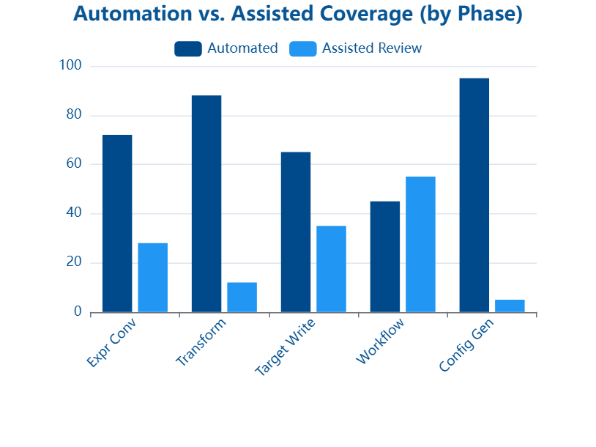

Conversion Coverage & Reliability Model
70% Fully Automated
Standard transformations are converted end-to-end with consistent PySpark templates. Includes Source Qualifier patterns, joins/filters, common Expression logic, and target write scaffolding. Auto-generates config placeholders, code structure, and logs—so most mappings are ready with minimal validation only.
30% Flagged & Reviewed
Complex logic is automatically detected and flagged for human review. Covers nested IIF/DECODE chains, custom SQL overrides, lookup edge cases, and Update Strategy (insert/update/delete) semantics. Tool adds clear TODO markers, highlights gaps, and provides guided suggestions to finalize business rules safely.

Slide 14
Connection Mapping & Target Database
MSSQL used for source + target. Informatica connection names auto-mapped to deployment-specific database aliases. Fixed target: msscdm_dev3.
Informatica Connection
Dev Alias
Target DB
Purpose
CDM_PRE_LANDING
msscdm_dev
msscdm_dev3
Pre-landing staging
CDM_PRE_LANDING_INV
msscdm_inv
msscdm_dev3
Inventory pre-stage
CDM_LANDING
cmx_ors_10_3
msscdm_dev3
Final landing zone
CDM_LANDING_INV
cmx_ors_inv
msscdm_dev3
Inventory landing

Slide 15
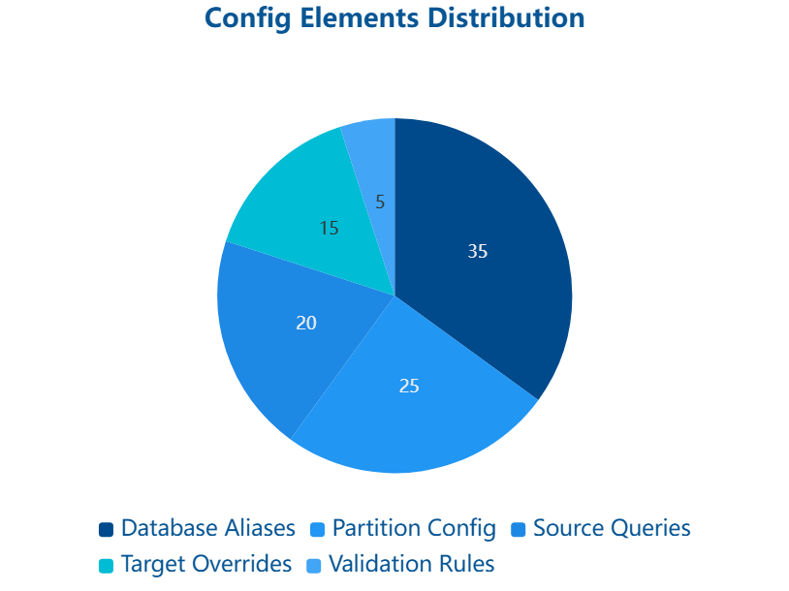
Config YAML Pattern & Environment Variables
Dynamic Configuration via
${VAR:default}
YAML config supports environment variable injection. Developers override values at runtime without code changes.
Example: source_db: ${DB_SOURCE:msscdm_dev} → uses DB_SOURCE env var, defaults to msscdm_dev if unset.

Slide 16
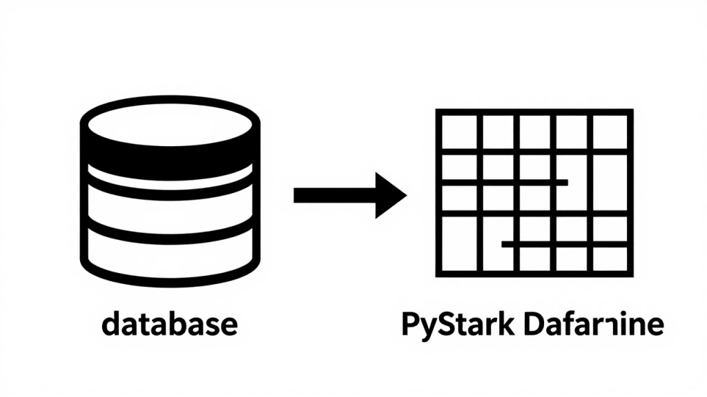
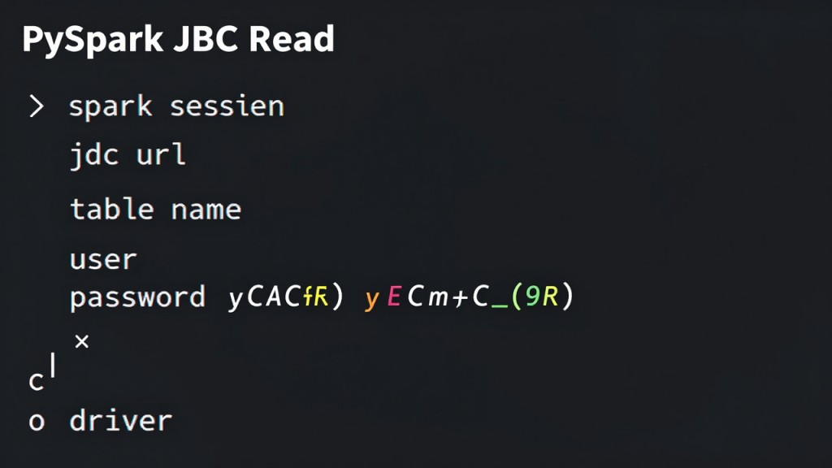
Source Reader Pattern: read_source(query)
JDBC Source Read
Code Example
read_source() executes SQL query against MSSQL source, returns DataFrame.
df = spark.read.format('jdbc') .option('url', jdbc_url) .option('query', sql_query) .load()
Supports parameterized queries, connection pooling, and partition pruning for performance.
Auto-configures partitioning, connection pools, and timeouts from config YAML.

Slide 17

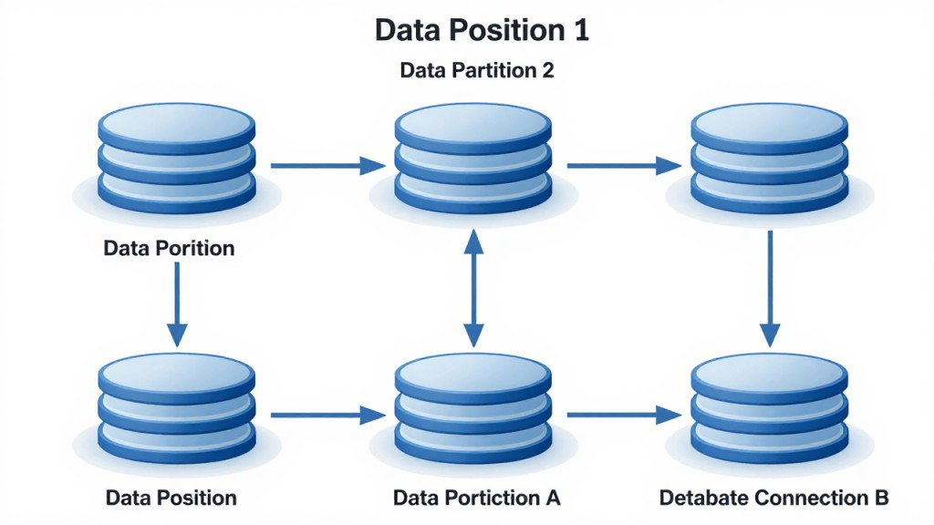
Target Writer Pattern: safe_write_jdbc + smart_repartition
Safe Write Pattern
Smart Repartitioning
safe_write_jdbc() handles insert/update logic, retry logic, and connection cleanup.
smart_repartition() tunes partition count based on data volume + cluster config.
Prevents data loss via transaction semantics and automatic rollback on failure.
Balances write parallelism: too many partitions → connection overhead; too few → serialization bottleneck.

Slide 18



Source Qualifier Conversion Patterns
Standard filter + aggregation logic auto-generated
Filtering & Predicates
Aggregations
Sorting
Joiner Logic
GROUP BY + SUM/COUNT/AVG translated to PySpark .groupBy().agg() with partitioning hints.
ORDER BY converted to .orderBy() with optional distributed sort for large datasets.
Informatica Joiner → PySpark SQL JOIN with join type preservation + null handling.
WHERE clauses converted to DataFrame .filter() with optimized logical operators.

Slide 19

Expression Conversion Examples: 40+ Functions Translated
Common Informatica functions → PySpark SQL equivalents
IIF & DECODE
Date Functions
String Functions
Null Handling
IIF(condition, true_val, false_val) → CASE WHEN; DECODE(col, val1, result1, default) → CASE statement.
TO_DATE(string, format) → to_date(string, format); ADD_TO_DATE(date, interval) → date_add(date, interval).
SUBSTR(string, start, len) → substr(); INSTR(string, pattern) → instr(); LTRIM/RTRIM/UPPER preserved.
NVL(col, default) → coalesce(col, default); ISNULL → is_null() / is_not_null().

Slide 20


Transformation Mapping: Standard Components (Automated 70%)
These components generate PySpark code with minimal review needed
Filter
Lookup
Aggregator
Sorter
Converts predicate logic to DataFrame.filter()
Translates lookup tables to DataFrame join with caching
GROUP BY + aggregate functions to .groupBy().agg()
ORDER BY to .orderBy() with distributed sort hints
Joiner
Router
Converts join type + keys to SQL JOIN syntax
Conditional routing to .filter() on DataFrame schema

Slide 21



Update Strategy & Sequence Generator (30% Review Zone)
Complex merge logic + auto-increment patterns—flagged for review
Update Strategy Logic
Sequence Generator
TODO Markers
Merge conditions (insert/update/delete) → PySpark SQL MERGE or UPSERT pattern. Flagged if custom conditions detected.
Informatica SEQ_* functions → Spark Sequence + monotonically_increasing_id(). Manual review for custom incrementing logic.
Auto-generated code includes TODO comments for complex merge strategies. Expression Converter + Improve Code Quality finalize the logic.

Slide 22
Workflow Orchestration + Demo + Roadmap
1
1. Start: Pilot Mapping
Select 1–2 mappings of varying complexity (simple filter, complex expression).
2
2. Convert & Review
Run converter → review report.json for warnings + TODOs → 70% auto-generated, 30% guided.
3
3. Validate & Tune
Schema check, row-count match, sample reconciliation. Resolve TODOs via Expression Converter.
4
4. Deploy + Iterate
Schedule PySpark job via Airflow/Databricks. Monitor performance. Add rules for future mappings. Continuous improvement.

Slide 23

Thank You — Questions?
Next: Start with a pilot mapping. The converter will show you exactly which patterns automate cleanly (70%) and where your expertise adds value (30%)

